Slide 1
Python project
GIF CREATOR USING THE
Guided by: Images WORK DONE BY:
MR.Vincent D.chandu
Python Programming for Statistical Research 192211232
CSA0810 C.S.E

Slide 2
INTRODUCTION
Python is a high-level, general-purpose programming language known for its readability and simplicity. It supports multiple programming paradigms, including procedural, object-oriented, and functional programming. Python is widely used for web development, data analysis, artificial intelligence, scientific computing, automation, and more.
Creating GIFs in Python can be a fun and creative way to express ideas, showcase animations, or add dynamic content to your projects. Whether you're a developer, designer, or hobbyist, Python provides powerful libraries and tools to easily generate GIFs
->the basics of GIF creation using Python, covering essential concepts such as image processing, frame manipulation, and exporting the final result. Get ready to breathe life into your static images and bring a touch of animation to your Python projects!

Slide 3
ABSTRACT
The Python GIF Creator is a versatile tool designed for the dynamic generation of GIFs from a series of images. Leveraging the capabilities of Python, the creator offers a user-friendly interface for users to compile, modify, and export animated GIFs effortlessly. The core functionalities include image processing, frame sequencing, and GIF optimization.
Key words:
Image Processing:The creator supports various image formats, allowing users to import a diverse range of image types.
Frame Sequencing:A user-friendly interface facilitates the arrangement and sequencing of frames to determine the flow and timing of the GIF animation.
GIF Optimization:The creator optimizes the final GIF output, ensuring a balance between file size and visual quality
Customization Options:Users have the flexibility to add text overlays, stickers, or other graphical elements to individual frames.
Export and Sharing:The Python GIF Creator supports seamless export of the finalized GIF, making it easy to share creations across various platforms.

Slide 4
REQUIREMENTS
->Creating GIFs in Python typically involves using a library that allows you to manipulate images and save them as a GIF. One popular library for this purpose is the MOVIEPY library (an improved fork of the original Python Imaging Library, ).
->images
->system (or)laptop
->visual video code (or)python compiler software
->images for converting int GIF
->suitable code

Slide 5
EXISTING SYSTEMS:
There are several existing libraries and tools in Python that you can use to create GIFs from videos. Here are a few popular ones:
imageio:is a Python library that allows you to edit image. It supports GIF creation from video files. You can use it to trim the video, add text, effects, and then save it as a GIF.
OpenCV:OpenCV is a computer vision library that also provides video processing capabilities. You can use it to extract frames from a video and then save those frames as a GIF.
mageio-ffmpeg:imageio-ffmpeg is an extension for the imageio library that allows you to read and write video files. You can use it to load a video and then save it as a GIF.
Each of these options has its own set of features and capabilities, so you may want to explore the documentation for each library to understand their full range of functionality.

Slide 6
PROPOSED SYSTEM:
Creating a GIF creator using video in Python typically involves using libraries that handle video processing and GIF creation. One popular combination of libraries for this task is OpenCV for video processing and image manipulation, and imageio for creating the GIF
Install Required Libraries:part is required to ensure that imageio has support for reading and writing video files.
Code Implementation:parameters allow you to specify a range of the video to convert to GIF.
Run the Script:Save the script, replace "input_image.mp4" with the path to your video file, and run the script. It should generate a GIF file named "output.gif" based on the specified parameters.

Slide 7
ARCHITECTURE:
Here's a high-level architecture
Import Necessary Libraries:Import required libraries like OpenCV for video processing and image manipulation, and imageio for creating GIFs.
Read Video File:Use OpenCV to read the input video file.
Process Frames:Iterate through each frame of the video, applying any necessary processing (e.g., resizing, cropping, or filtering) to prepare it for the GIF.
Create GIF:Use the imageio library to save the processed frames as a GIF.
Frame Processing Function:to handle any frame-specific processing. This may include resizing, cropping, applying filters, or any other enhancements.
Adjust GIF Parameters:Optionally, adjust parameters such as the GIF duration, frame rate, or other settings based on your requirements.

Slide 8
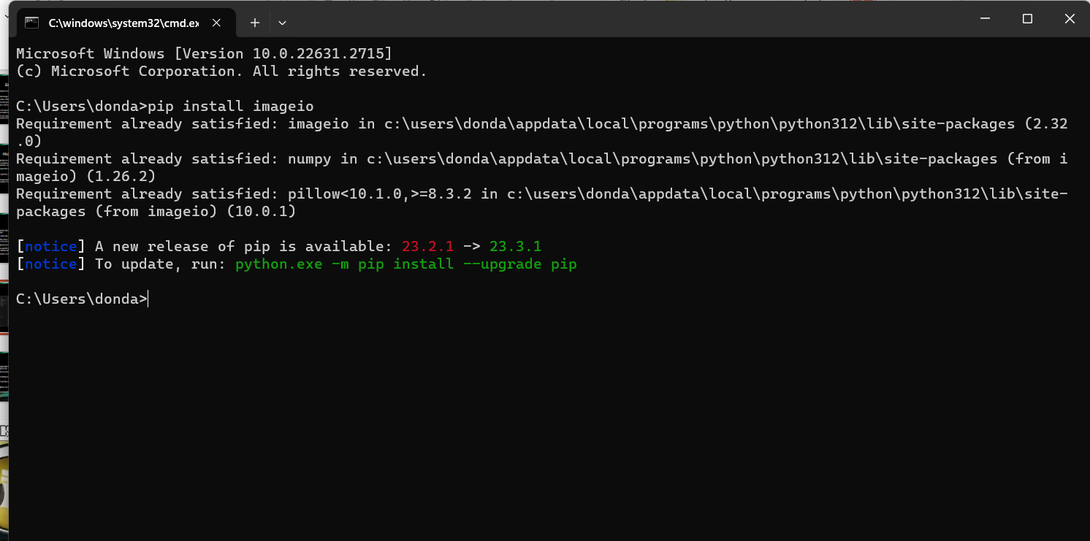
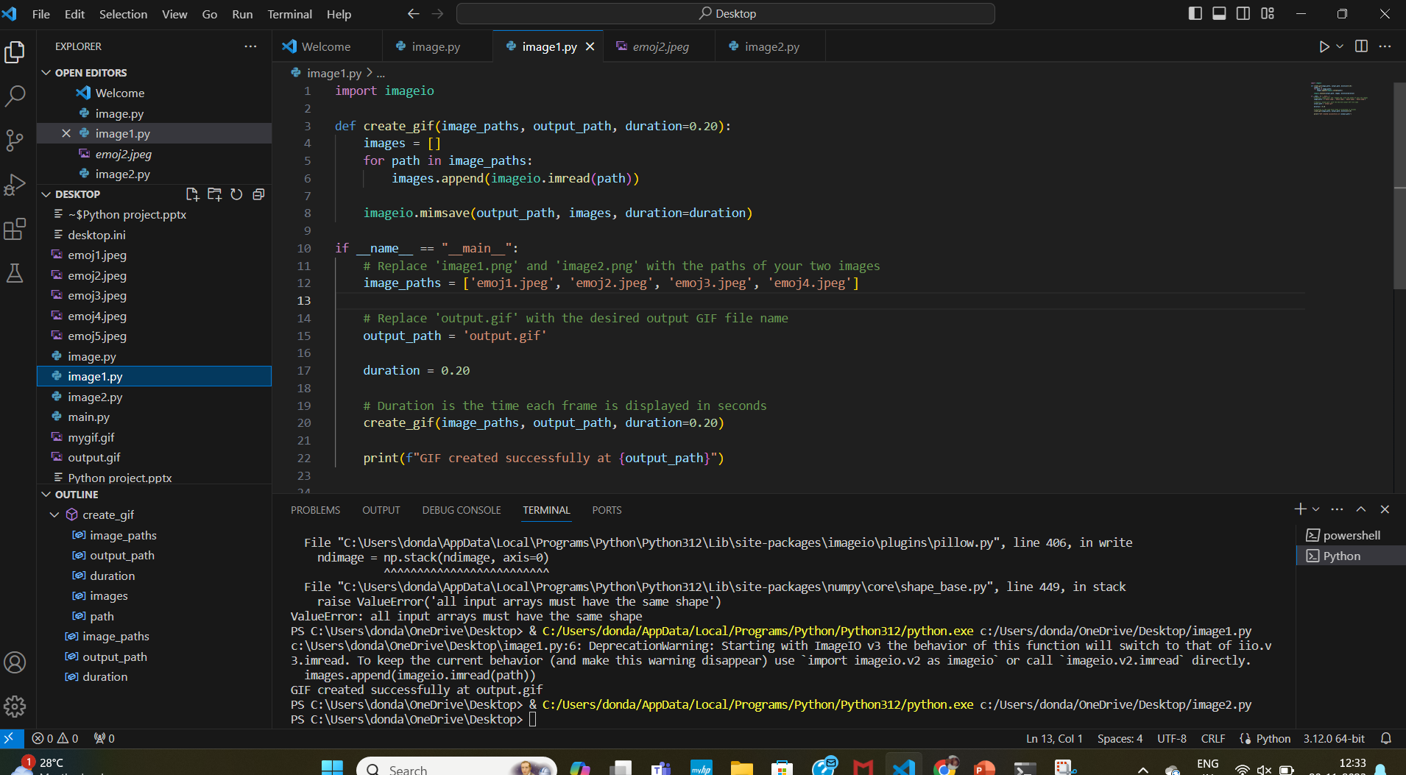
Coding:

Slide 9
TESTING:
1)Unit Testing:Test the functions or methods responsible for extracting frames from the video, converting frames to images, and creating the GIF.
2) Mocking:This allows you to isolate the specific functionality you want to test without relying on the complete integration.
3) Integration Testing:Use sample video files for testing to ensure the consistency of the process.
4) Test Automation:Continuous Integration (CI) tools like Jenkins, Travis CI, or GitHub Actions can be used to automate testing.
5) Error Handling:Ensure that appropriate exceptions are raised, and error messages are clear and helpful.
6) Code Coverage:Aim for high code coverage to ensure that most parts of your code are exercised during testing.

Slide 10
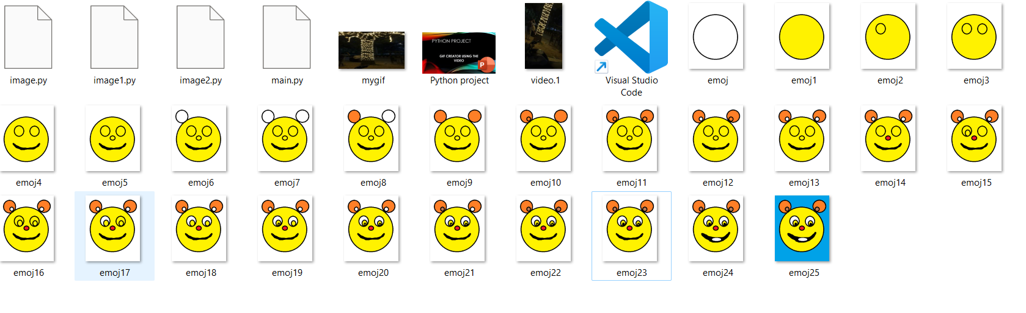
FINALL OUTPUT:

Slide 11
IMPLEMENTATION:
1)Make sure you have the necessary libraries installed.
2) Now, you can write a Python script to create a GIF from a video
3) Save the script to a file
4) run it using a Python interpreter:

Slide 12
CONCLUSION:
->In Python, creating a GIF from a video is a straightforward process thanks to various libraries like OpenCV and imageio. By leveraging these tools, you can extract frames from a video, modify them as needed, and then compile them into a GIF.
->Remember to handle exceptions appropriately, especially when dealing with file I/O and video processing, to ensure the robustness of your script. Creating a GIF from a video in Python is a versatile process, allowing you to customize the output according to your needs.

Slide 13
Future scope:
User-Friendly Applications: Develop user-friendly applications that allow users to easily create GIFs from videos. This could involve building graphical user interfaces (GUIs) using frameworks like Tkinter or PyQt.
Web Integration: Integrate the GIF creation functionality into web applications, allowing users to convert videos to GIFs directly through a web browser. Flask or Django can be used for web development.
Social Media Integration: Implement features that enable users to share their created GIFs directly on social media platforms. Integration with APIs of platforms like Twitter, Instagram, or Facebook could be explored.
Advanced Editing Features: Enhance the tool with advanced editing features, such as adding text, filters, stickers, or other elements to the GIF. This can make the tool more versatile and appealing to a broader audience.
Cloud Integration: Provide options to store and manage created GIFs in the cloud. Users could have the ability to access their GIFs from multiple devices.
Machine Learning Enhancement: Explore the integration of machine learning algorithms for automatic scene detection, background removal, or other advanced video processing techniques to improve the quality of the resulting GIFs.
Performance Optimization: Focus on optimizing the performance of the GIF creation process, especially for large or high-resolution videos, to ensure a smooth user experience.
Cross-Platform Compatibility: Ensure that the GIF creator works seamlessly across different operating systems (Windows, macOS, Linux) and stays up-to-date with the latest Python and library versions.

Slide 14
Reference:
1)The create_gif function takes the input video path, output GIF path, and an optional duration parameter (specifying the time each frame is displayed in the GIF). It uses the imageio library to read frames from the video and write them to a GIF file.
2)Make sure you have the necessary codecs and libraries installed for reading the video. The imageio[ffmpeg] installation includes the FFmpeg library, which is commonly used for video processing.

Slide 15


